Slide 1
CIS DevSecOps
11/21/2019
Notes:
Title slide [uses Title Slide (Background Image) layout]
The brand mark and data art graphic on this slide layout are set up at the correct size and position and should not be altered.
The presentation title appears in Arial (Experian Dark Blue); other presentation details should be in Arial (Grey) and separated by a single line space, as shown in this example. It is important to ensure that the title and supporting text is always fully legible on an image background.
The background image has been placed in the slide layout master as a ‘background fill’; this can be edited by right-clicking the background image area and choosing ‘Format Background…’ from the context menu to replace the image. The full-colour brand mark and data art graphic must always appear on a light-coloured background with maximum legibility; image backgrounds should be carefully selected with this in mind.

Slide 2
Team Charter
Team Patagonia
Product Owner (PO)
Amit Awati (US)
Tech Lead & Scrum Master
Jaime Muñoz (CH)
Engineering Manager (EM)
Alvaro Fuenzalida (US)
Team Members
Sirigireddy, Sreelatha (IN)
Kuppili, Priyanka (IN)
Moka, Manoj (IN)
Ponnala, Madhukar (IN)
Badeti, Rajeshwari (IN)
Adhikari Biswash (US)

Slide 3
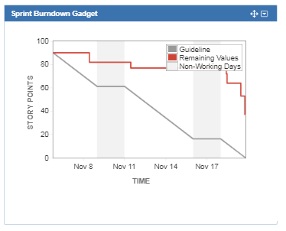
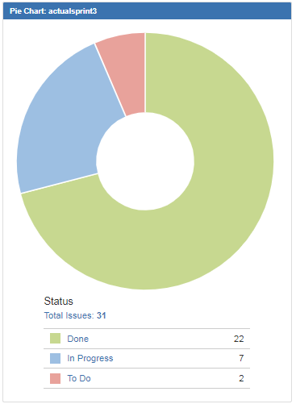
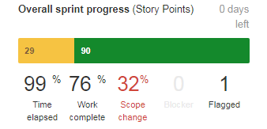
Sprint # Progress Summary

Slide 4
Sprint Goals and Details Status Report
Summary | Current Status | Comments
Jenkins metrics | Completed
CECL CI/CD - requirements | Completed
Regression Online for Credit Reporting Automation | Completed
Generation of DevSecOps KPIs - design | Completed
Robot Framework Onboarding | Completed
#289 File One implementation release | Completed
#290 File One implementation release | Completed
Volume 10K Y Region inclusion | Completed
AWS S3 plugin for Cloudbees | In progress | Pending installation from EITS
ALLOUT enhancements | Completed
Boost 1 - Configuration | Completed
Integration between AWS S3 and Openshift EMR | In progress | Pending Firewall rules

Slide 5
PI Sprint Delivery Dashboard

Slide 6
Demo and Q&A
Demo Scope Summary
ALLOUT Enhancements (Sreelatha Sirigireddy)

Slide 7
Q & A
Notes:
Closing slide [uses Holding Slide layout]
This slide can be used as a ‘closing’ slide and should not include any additional text or graphics. The same slide layout is used as a presentation opening slide. The brand mark and data art graphic on this slide layout are set up at the correct size and position and should not be altered.

